Slide 1

Hannah Babe and Alessandra Vennema
AIT-Budapest
Spring 2022, Deep Learning Final Presentations
Audio Spoof Detection

Slide 2
Introduction
Background: With systems being increasingly vulnerable to scams, spoof detection applications are an important tool to protect consumer privacy and security
Goal: Implement a model that can identify when a piece of audio is fake and/or manipulated

Slide 3
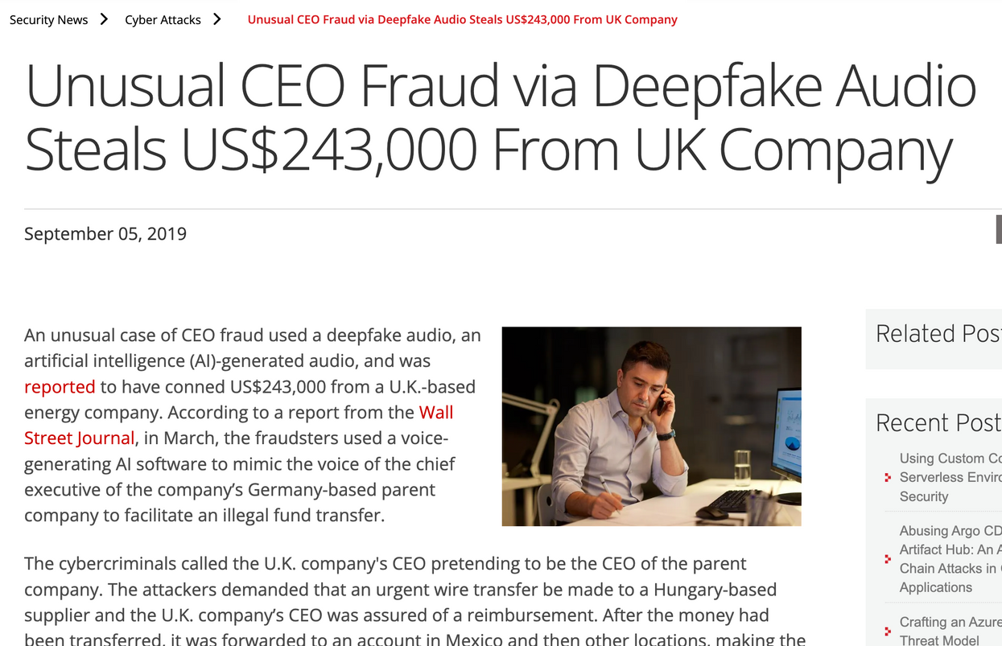
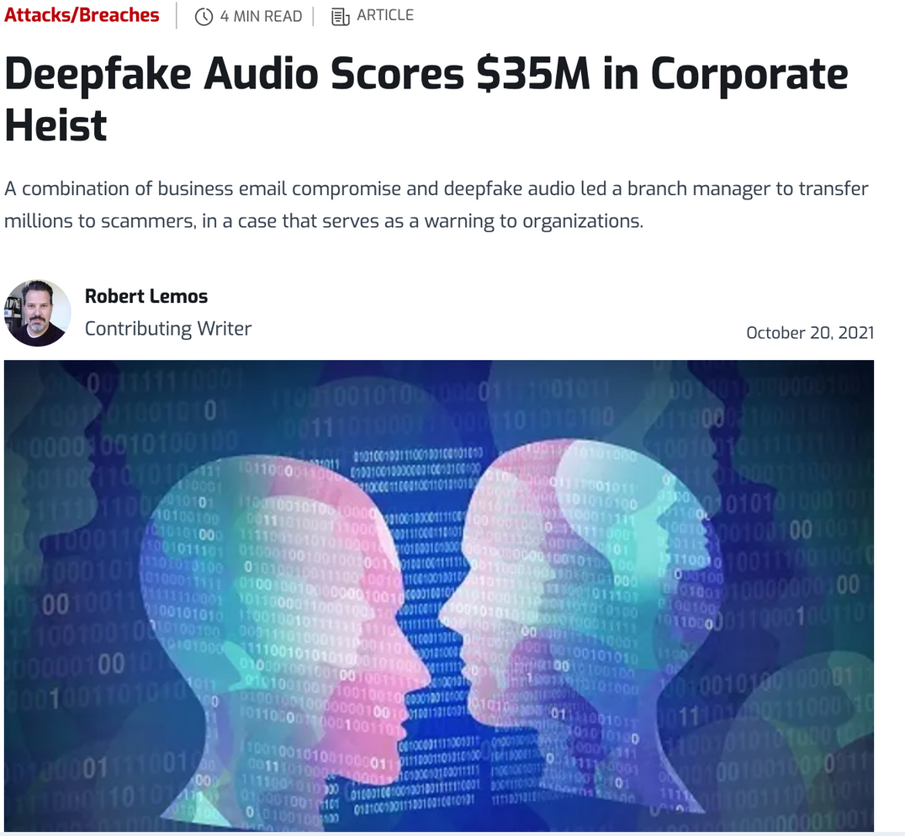

Slide 4

Can you guess the real audio?

Slide 5
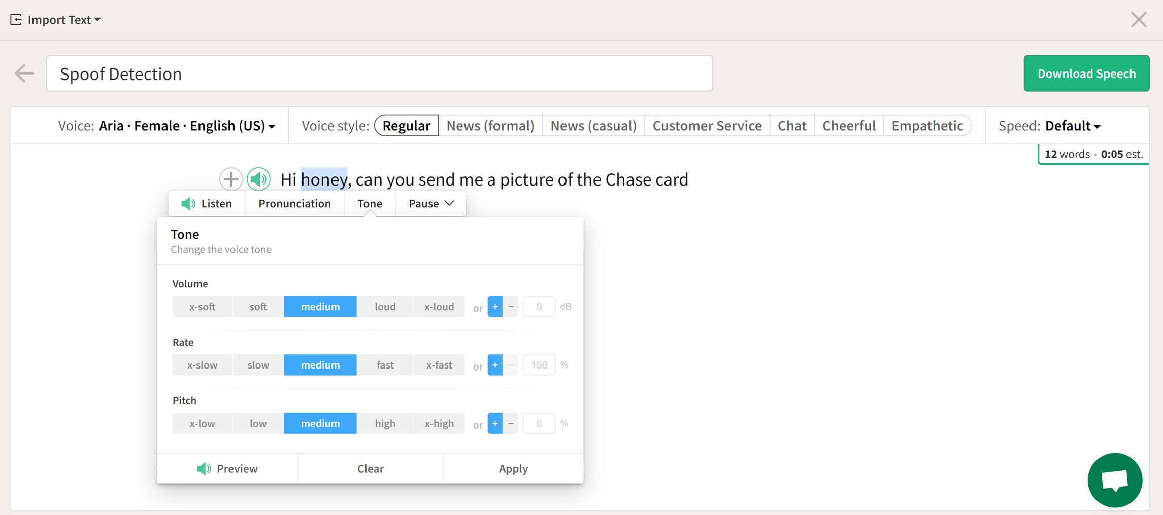
Source: https://play.ht/text-to-speech-online/

Slide 6


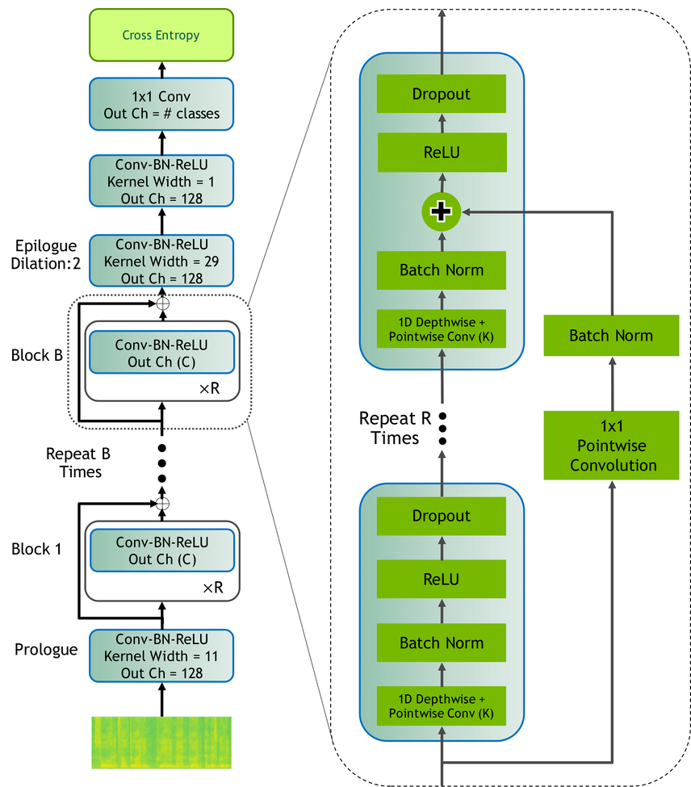

Resources
(Spoofing Aware Speaker Verification)

Slide 7
Chosen Method
Conv2D
recognize patterns
Batch Normalization
accelerates the training of deep neural nets
Dropout
prevent co-adaptation, where the neural network becomes too reliant on particular connection
Max Pooling
adds a small amount of translation invariance and therefore
overfitting by consolidating features
learned by the conv layer feature map

Slide 8
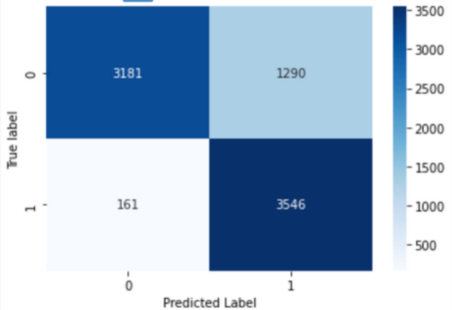
Audio Spoof, Confusion Matrix
Results
Initial accuracy of 99% and loss of 0.0348.
On evaluation dataset 82% accuracy and loss of 4.88

Slide 9
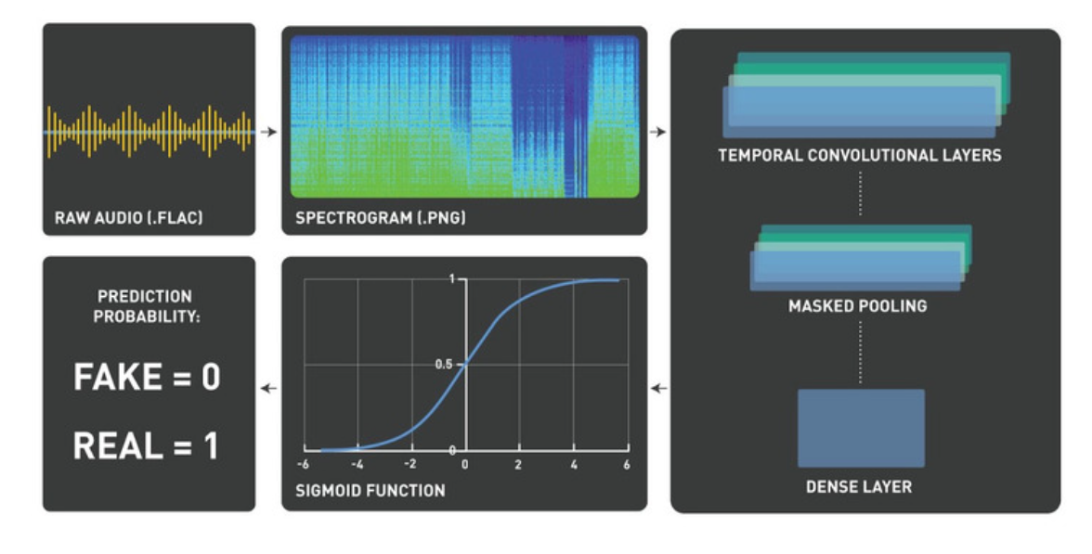
Disscussion
Increase model accuracy, potentially by using a pre-trained model
Usability of solution for real-time results
Secure

Slide 10
Thank you for Listening
Questions?

